Slide 1
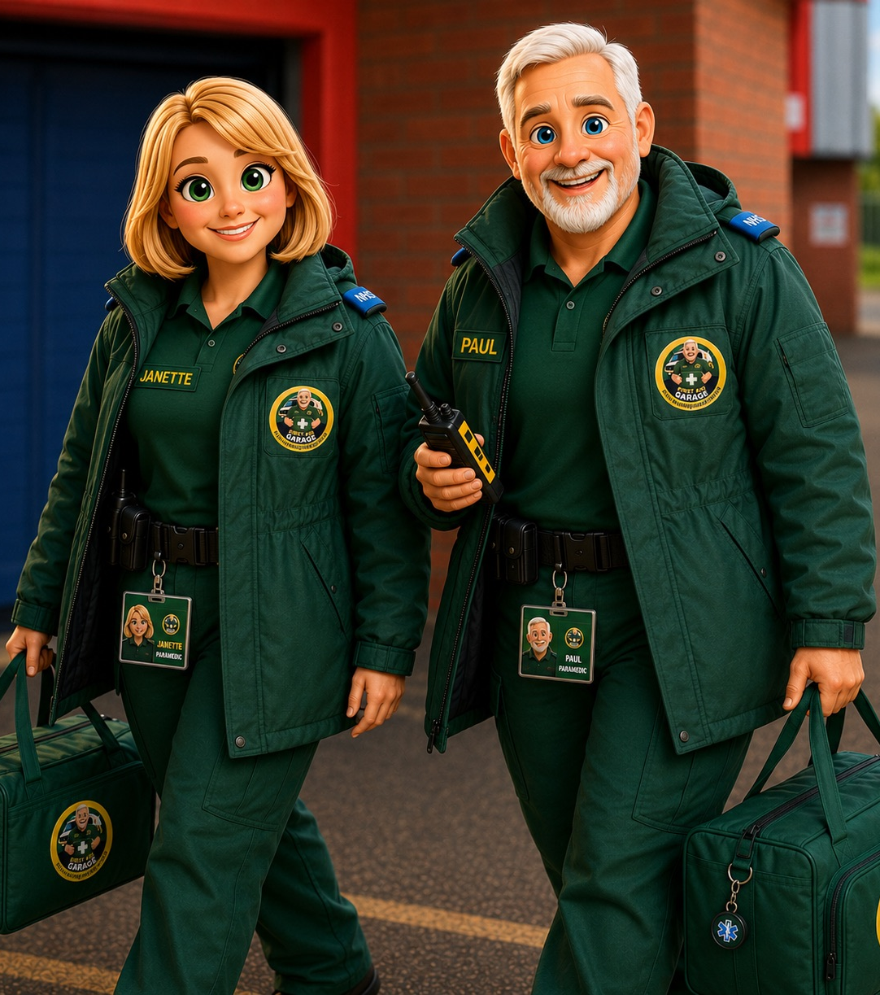

HEAD INJURY
STAFF EMERGENCY ACTION CARD
ASSESS THE CHILD • ACT ON CONCERN • RECORD CLEARLY
A practical refresher for nurseries, schools and childcare teams.
What to do for a minor bump
What to watch for
When to seek urgent help
FIRST AID
Helping Schools
Save Lives
www.firstaidgarage.co.uk
GARAGE
01204 588627 | info@firstaidgarage.co.uk
Notes:
[Sources]
NHS: https://www.nhs.uk/conditions/head-injury-and-concussion/
Introduce the card as a practical reminder: a cold pack may help a minor bump, but assessment and observation are the priority.

Slide 2
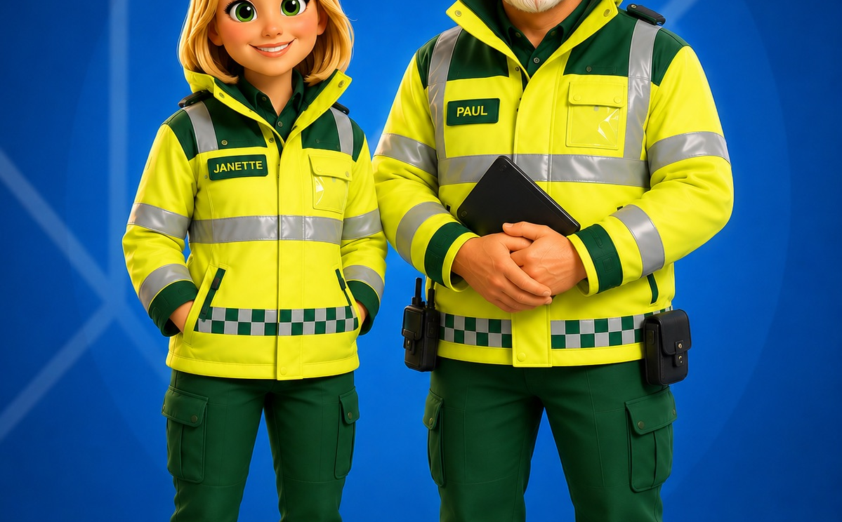
FIRST AID
Helping Schools
Save Lives
STAFF EMERGENCY ACTION CARD
GARAGE
HEAD INJURY
Start with the child — not the bump
CALL 999 IF THE CHILD IS UNCONSCIOUS, HAS A SEIZURE OR IS SERIOUSLY UNWELL
1 CHECK
2 PROTECT
3 DECIDE
Response, breathing and immediate danger.
Look for a significant mechanism of injury, neck pain or a change from normal behaviour.
Avoid unnecessary movement if a neck or spinal injury is possible.
Keep the child comfortable and reassure them.
Use 999 for an emergency.
Use NHS 111 or seek urgent assessment when symptoms are concerning.
Trust your assessment. If something does not feel right, escalate.
www.firstaidgarage.co.uk
01204 588627 | info@firstaidgarage.co.uk
2
Notes:
[Sources]
NHS: https://www.nhs.uk/conditions/head-injury-and-concussion/
The size of a bump is not the deciding factor. Start with response, breathing, mechanism and any change from the child’s usual state.

Slide 3
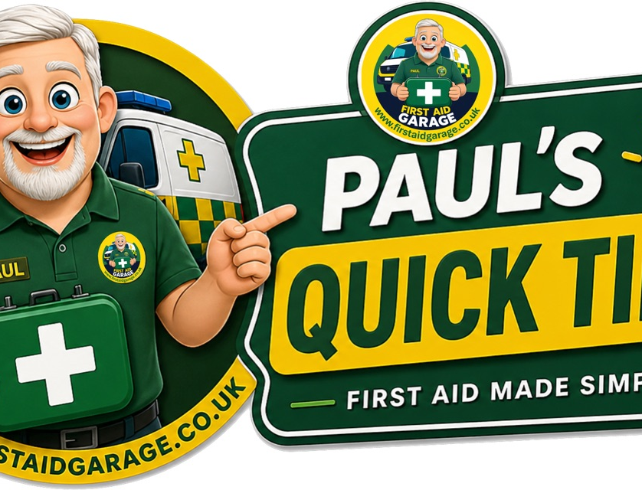
FIRST AID
Helping Schools
Save Lives
STAFF EMERGENCY ACTION CARD
GARAGE
HEAD INJURY
For a minor bump: cool, comfort and observe
A COLD PACK HELPS SWELLING — IT DOES NOT RULE OUT A HEAD INJURY
Use cold safely
A cold compress, commercial cold pack or wrapped ice pack may reduce swelling and discomfort. Never place ice directly on skin.
Keep observing
Use the cold pack for short periods. Check the child’s comfort and skin. If symptoms worsen or you are concerned, seek help.
www.firstaidgarage.co.uk
01204 588627 | info@firstaidgarage.co.uk
3
Notes:
[Sources]
NHS: https://www.nhs.uk/conditions/head-injury-and-concussion/
NHS guidance supports using a wrapped ice pack for a minor head injury. Use short periods, avoid direct skin contact and continue to observe.

Slide 4
FIRST AID
Helping Schools
Save Lives
STAFF EMERGENCY ACTION CARD
GARAGE
HEAD INJURY
Red flags: act promptly
DO NOT WAIT FOR SYMPTOMS TO “SETTLE” IF THE CHILD IS DETERIORATING
Changes in awareness
Vomiting or headache
Other serious signs
Increasing drowsiness, confusion, unusual behaviour, weakness, poor balance or problems speaking/understanding.
Repeated vomiting or a worsening headache needs prompt medical advice.
A seizure, loss of consciousness, blood or fluid from ears/nose, or anything seriously concerning.
Emergency: 999 Concerned but not an emergency: NHS 111
www.firstaidgarage.co.uk
01204 588627 | info@firstaidgarage.co.uk
4
Notes:
[Sources]
NHS: https://www.nhs.uk/conditions/head-injury-and-concussion/
Use professional judgement. The listed signs are not exhaustive: if the child is seriously unwell, call 999.

Slide 5
FIRST AID
Helping Schools
Save Lives
STAFF EMERGENCY ACTION CARD
GARAGE
HEAD INJURY
Observation and parent handover matter
CLEAR RECORDS HELP EVERYONE MAKE THE RIGHT NEXT DECISION
1
OBSERVE
Stay with the child and notice any change from their normal behaviour.
2
RECORD
Time, mechanism of injury, symptoms, treatment and observations.
3
SHARE
Tell the parent/carer clearly what happened and what to watch for.
4
ESCALATE
Follow your setting’s accident and safeguarding procedures; seek advice when concerned.
www.firstaidgarage.co.uk
01204 588627 | info@firstaidgarage.co.uk
5
Notes:
[Sources]
NHS: https://www.nhs.uk/conditions/head-injury-and-concussion/
Records should include what happened, when, symptoms observed, treatment given, actions taken and the parent/carer handover.

Slide 6
THE SIMPLE MESSAGE
A wrapped cold pack is still appropriate for a minor bump.
But careful assessment, observation, clear records and acting on concern are what keep children safe.
NHS guidance: nhs.uk/conditions/head-injury-and-concussion
FIRST AID
Helping Schools
Save Lives
www.firstaidgarage.co.uk
GARAGE
01204 588627 | info@firstaidgarage.co.uk
Notes:
[Sources]
NHS: https://www.nhs.uk/conditions/head-injury-and-concussion/
Close by repeating the distinction: cold treatment may be appropriate, but it never replaces observation and escalation when there is concern.

